Slide 1


DOLLING APP
Notes:
Bintang

Slide 2
B21-CAP0114
Bintang Fathur Rahman (A0060605)
Muhammad Hisyam Zayd (A0060600)
Yohana Polin Simatupang (C1141458)
Gustavo Thiodorus (C0060598) Rian Nugroho (M0060602) Tiara Yania Ifani Lakita (M2082041)
Notes:
Bintang

Slide 3
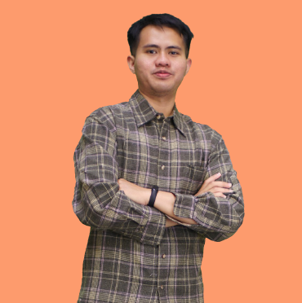
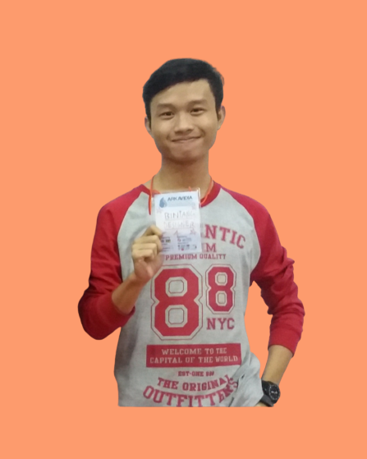

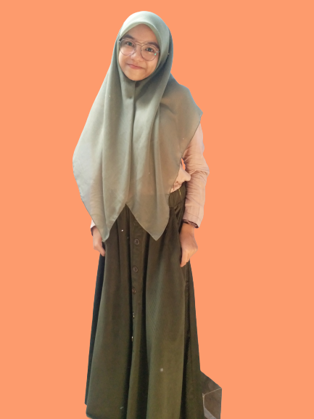

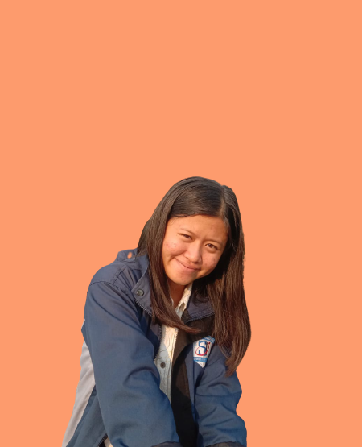
SaKe Team Here!
B21-CAP0114
Hisyam
Bintang
Rian
Tiara
Gustavo
Yohana
Notes:
Bintang

Slide 4



Background
Missed Time
Erratic location
Enthusiasts Decreased
The arrival of the Pedagang Keliling was uncertain
Pedagang Keliling doesn't have permanent stalls so the location of the seller is uncertain due to walking around.
The decreasing number of Pedagang keliling in Indonesia, especially traditional food Pedagang Keliling
Notes:
Bintang

Slide 5
Why Dolling?
Availability
Make it easy for buyers to find out the location of sellers. So that buyers do not need to seek / wait for the uncertainty of Pedagang Keliling. With tracking provided by Doling, buyers and sellers can know each other's location.
Strategy
and Solution
Increased Interest
Dolling is one of economy resilience solutions for Pedagang Keliling
Make it easier for buyers to order food of their choice through the application, so the interest of what Pedaganng Keliling offers will be increasing.
Fast Tansactions
Using the method of ordering through the application, Dolling can streamline the business processes of Pedagag Keliling. So that will increase the number of sales and of course profits. For the buyer, it is very beneficial that they do not have to wait for "uncertainty" .
Notes:
Tiara
because buyers who are looking for food from Pedagang Keliling will know where to order

Slide 6



Similar Project Studied
“Aplikasi E-Food Khusus Pedagang Keliling”
What Makes Our Solution Differents
Recommendation Features
This recommendation will use feedback from buyers so that we can provide food suggestions according to what buyers like. This feature also helps Pedagang Kelilng find groups of buyers who like the products provided.
Food similarity features
The similarity feature is used to display similar foods according to input from buyers. This feature will find out the name of the food if the buyer does not know the name of the food. Usually this case often occurs in traditional foods which sometimes have different names in each region
Notes:
Tiara

Slide 7
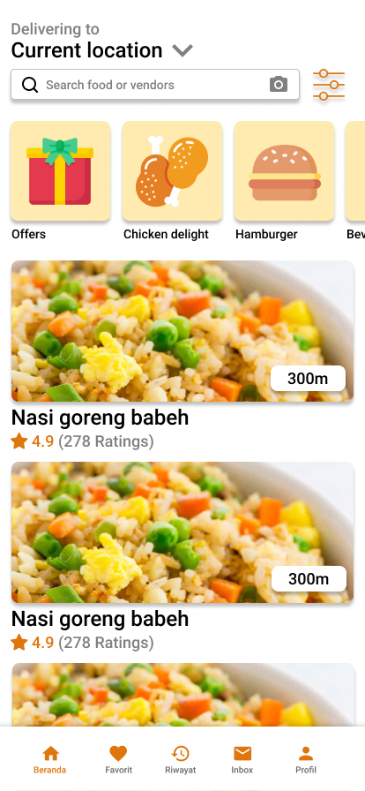
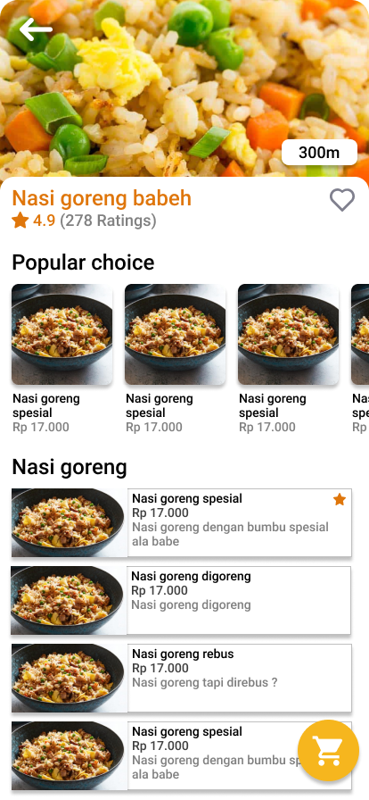
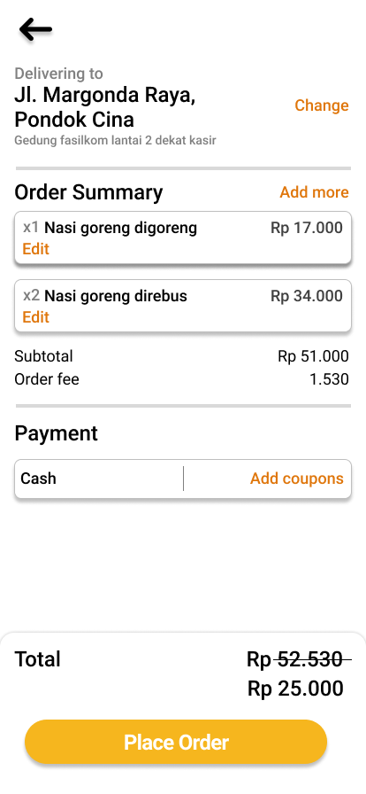
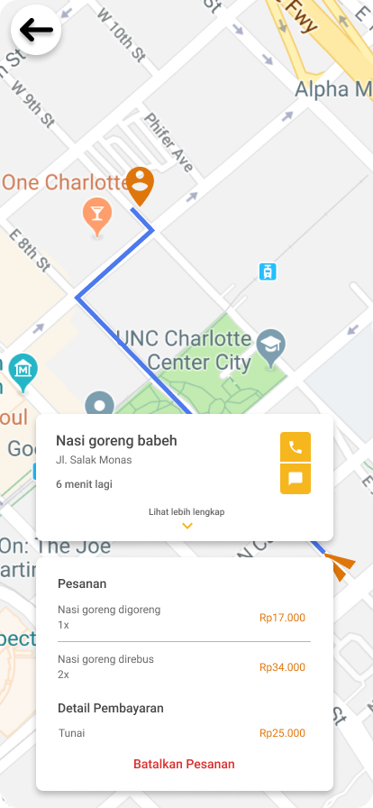
Buyer UI Design
Notes:
Bintang

Slide 8
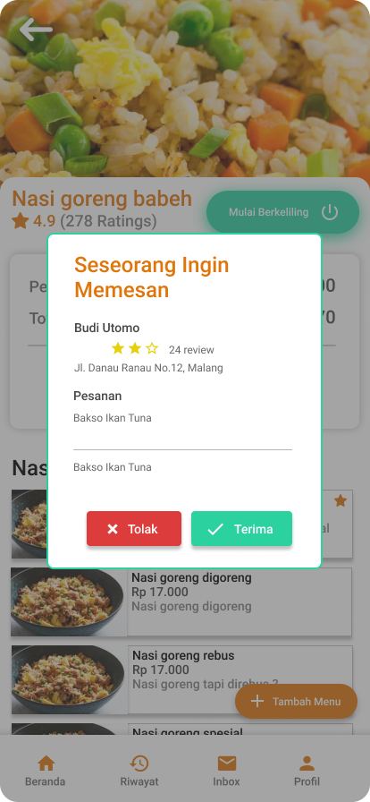
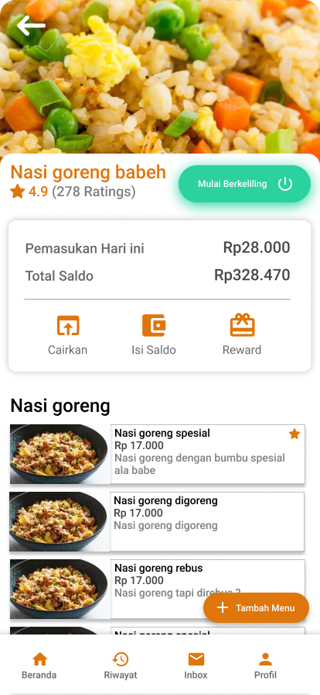
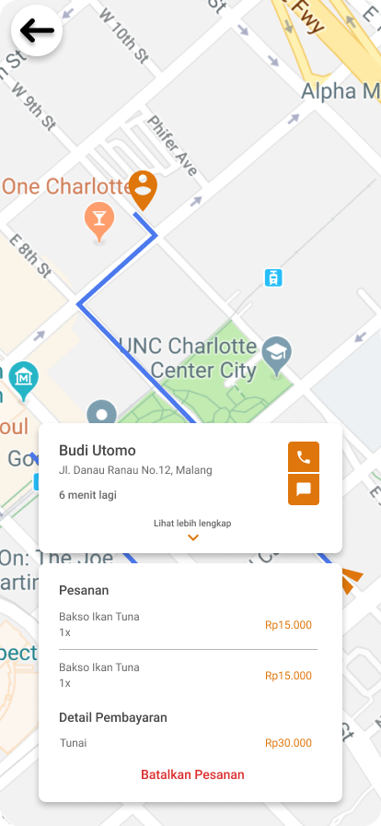
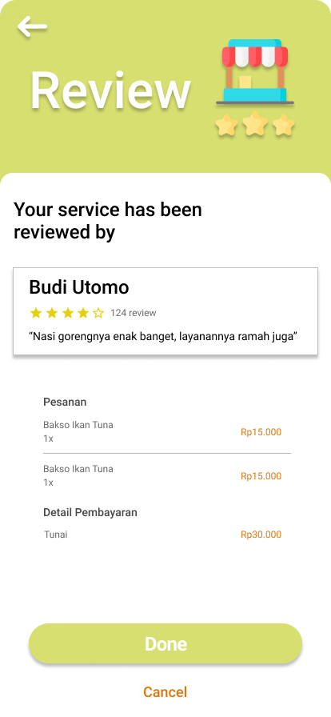
Seller UI Design
Notes:
Bintang

Slide 9



Collaborate In Project
Android Contibution
Machine Learning Contibution
Cloud Computing Contibution

Slide 10
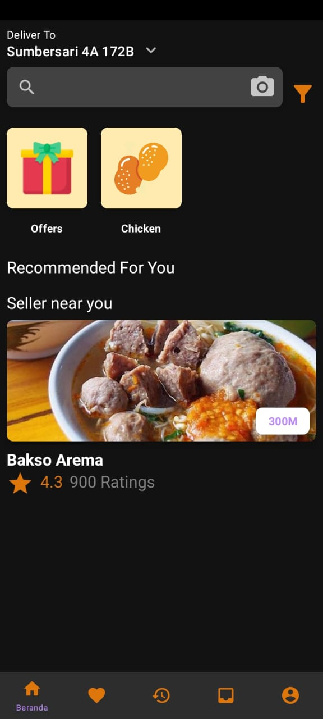
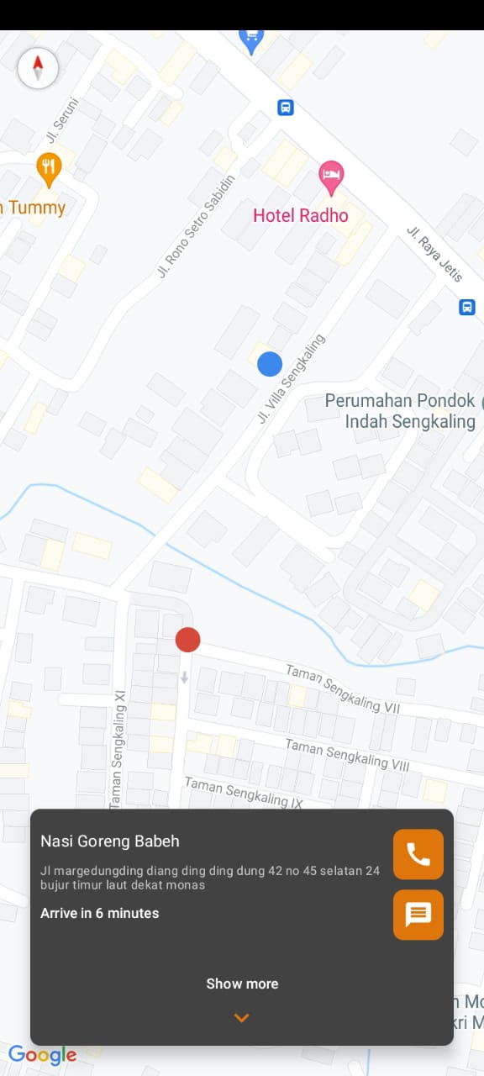
Android
DOLLING - BUYER APP
DOLLING consist of two main android mobile application: application for buyer and application for seller.
Main application flow for buyer app:
Buyer choose seller (recommended or nearest seller)
Buyer pick food menus and quantities as desired
Buyer do checkout (order confirmation), map activity will appear and show live location of buyer and seller
Buyer give service review for seller
Notes:
Hisyam

Slide 11
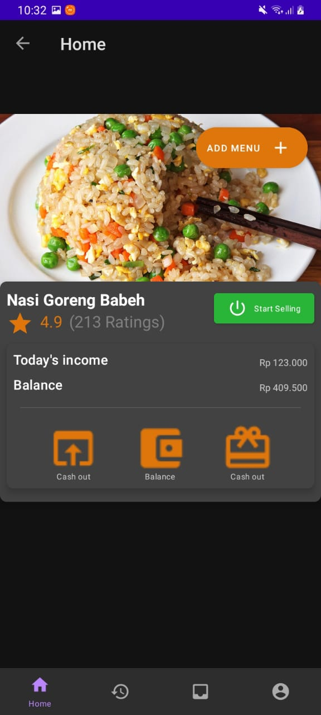
Android
DOLLING - SELLER APP
Main application flow for seller application:
Seller do registration for account
Seller create food menu
Seller turn on ‘track’ mode so buyer know if seller is being active
Seller receive and confirm buyer order
Seller can know buyer review
Notes:
Hisyam

Slide 12
Machine Learning
Recommendation
Recommendations use the Nearest Neighbor algorithm where the algorithm displays N recommendations to the user. The algorithm uses the scikit-learn library to simplify implementation. Recommendations work by providing recommendations for other relevant traders given a trader and his info. The features used are coordinates, rating, total rating, and food category. Recommendations are given based on the same food category and some are not from the same food category.
Image Similarity
Food Image Similarity, we use the CNN model with 3 Convolution + maxpool layers and 2 dense layers with a total parameter of up to 17 million parameters. The model doesn't use a pre-trained model, but makes it from scratch. By using 10 classes and 1000 images for each class, the model gets a train accuracy of 86%, but gets a validation accuracy of 42%.
Notes:
Rian

Slide 13
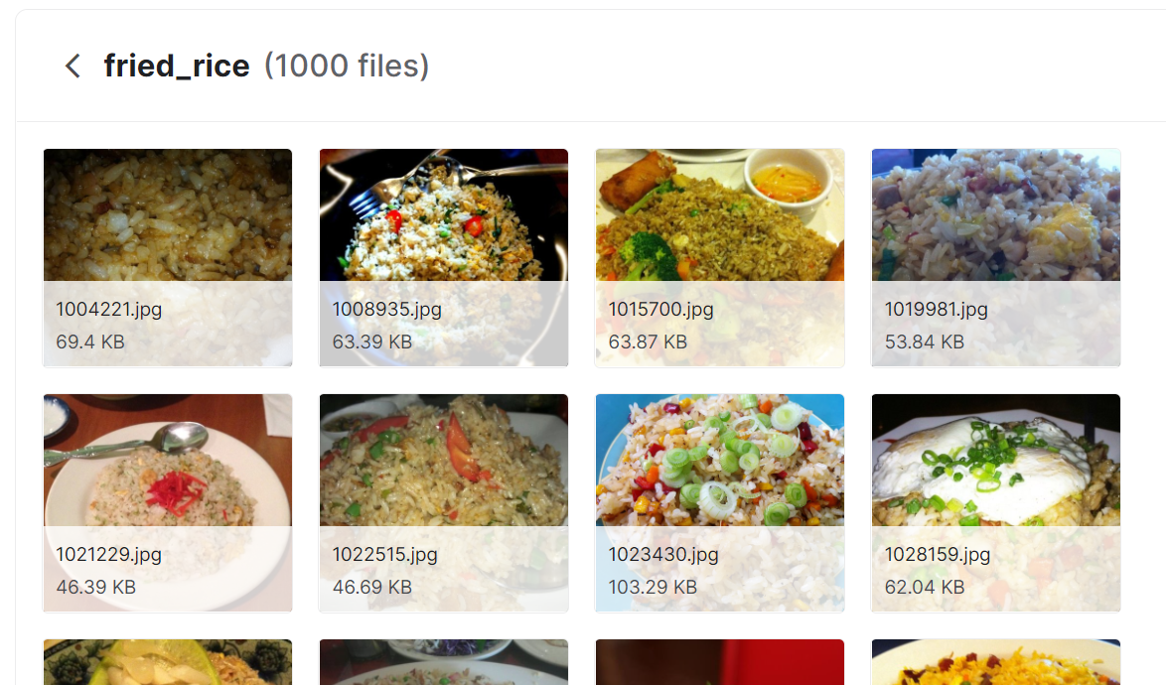
DATASET
For recommendation, because we are using NearestNeighbors and this algorithm is not a learning algorithm, we just randomly generated dataset. During our testing, we are randomly generated vendor example from Kota Malang, Jawa Timur.
For the food similarity dataset, we are using food101 as our datasets because this datasets contains 101 class with 1000 example each. For this project purpose, considering the limitation of computational power, we are only using 10 class with 1000 examples. Each example is an image with size 384x384 with 3 color channel, RGB.
Notes:
Rian

Slide 14
Cloud Computing
ML Model Deployment
ML model deployment will use AI Platform as a GCP service. Machine learning models that previously trained by machine learning engineers will be stored in Google Cloud Storage. Next, the model will be created in the AI platform by adjusting the environment of the saved model. An URL then created and our app can send data by sending JSON file with speficic format using POST method and will get result as requested.
Firestore storage
Our app using NoSQL database in order to deliver fast data transcations with scale out architecture (Firestore). Unstructured data like images will stored in Cloud Storage. Android applications using firebase service which connected to GCP Firestore and Cloud Storage to store the data.
Notes:
Gustavo

Slide 15






GCP Infrastructures
Architecture: Mobile App
dolling app
Model AI platform
Database Storage Cloud Storage
Database Storage Cloud Storage
Firebase
Databases Firestore
Notes:
Gustavo

Slide 16

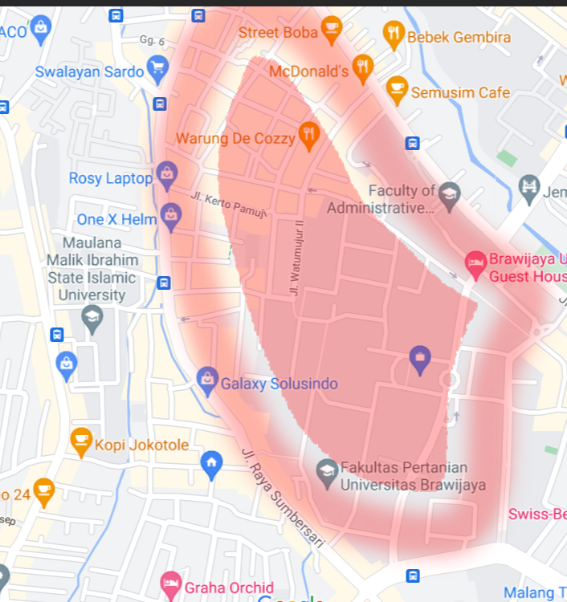
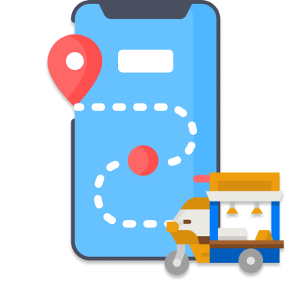

Future Feature Improvement
Pedagang keliling safety mode
Heatmap Feature
Pedagang keliling tracker
Integration with another app
Notes:
Gustavo

Slide 17


Timeline
Development Plan
Budget

Slide 18
Timeline
Business and Project Plan
Business Plan
Get Patnership
Project Implementation
Layout
Create Moel
Database integration
Backend API
Project Implementation
Security Testing
UI/UX Testing
Database normalization
JULY
SEPTEMBER
NOVEMBER
AUGUST
OCTOBER
DECEMBER
Project Design
Database Design
Infrastructure Design
UI/UX Design
Project Implementation
Firebase Integration
Training Model
Backend ML Model
Project Closing
Project Closure
Training App for Pedagang Keliling and promotion
Notes:
Yohana

Slide 19
WBS items | month | Unit | Cost | subtotals | WBS level 2 totals | % of total
1.Human Resources |  |  |  |  | Rp 42.400.000,00 | 61%
1.1. External Human Resources
1.1.1 UI/UX Design | 1,00 | 1,00 | Rp 5.000.000,00 | Rp 5.000.000,00
1.1.2 Business Analyst | 1,00 | 1,00 | Rp 5.000.000,00 | Rp 5.000.000,00
1.2. Project Team
1.2.1 Mobile Developer | 6,00 | 2,00 | Rp 900.000,00 | Rp 10.800.000,00
1.2.2. Backend or cloud Engineer | 6,00 | 2,00 | Rp 900.000,00 | Rp 10.800.000,00
1.2.3. Machine Learning Engineer | 6,00 | 2,00 | Rp 900.000,00 | Rp 10.800.000,00
2. Source Tech |  |  |  |  | Rp 12.650.000,00 | 18%
2.1 GCP Service
2.1.1 Compute Egine | 5,00 | 2,00 | Rp 500.000,00 | Rp 5.000.000,00
2.1.2 Cloud Run | 5,00 | 1,00 | Rp 200.000,00 | Rp 1.000.000,00
2.1.3 AI Flatform | 5,00 | 1,00 | Rp 300.000,00 | Rp 1.500.000,00
2.1.4 Cloud Load Balancer | 6,00 | 1,00 | Rp 300.000,00 | Rp 1.800.000,00
2.1.5 Cloud Pub/Sub | 5,00 | 100 GiB | Rp 80.000,00 | Rp 400.000,00
2.1.6 Big Query ML | 5,00 | 1,00 | Rp 240.000,00 | Rp 1.200.000,00
2.2 Firestore | 5,00 | 100 GiB | Rp 200.000,00 | Rp 1.000.000,00
2.4 Apple Store | 1,00 | 1,00 | Rp 350.000,00 | Rp 350.000,00
2.5 Playstore | 1,00 | 1,00 | Rp 400.000,00 | Rp 400.000,00
3. Business Cost |  |  |  | Rp 6.000.000,00 | Rp 7.950.000,00 | 11,36%
3.1. Market Analysis |  |  | Rp 4.000.000,00
3.2. Competitor Analysis |  |  | Rp 2.000.000,00
3.3. ads payment |  |  |  | Rp 900.000,00
3.3.1 Youtube Ads | 3 |  | Rp 300.000,00
3.3.2 Instagram | 3 |  | Rp 600.000,00
4. Internet Kuota | 3 | 7 | Rp 50.000,00 | Rp 1.050.000,00
reserved |  |  |  | Rp 7.000.000,00 | Rp 7.000.000,00 | 10%
TOTAL |  |  |  |  | Rp 70.000.000,00 | 100%
Budget
Notes:
Yohana

Slide 20
Dolling Roadmap
Commercial Value
Mobile app for supporting Pedagang Keliling Indonesia.
Economy Resilience for Pedagang Keliling
Demands and Supplies
Increased demand from Food and Beverage services, especially for street culinary (Pedagang Keliling), and the absence of services that facilitate the online transaction process for Pedagang Keliling. Dolling supply one solution for Pedagang Keliling to market their product.
Business Opportunities
Ads from partnerships on Dolling app
Percentage of accommodation of products sold by Pedagang Keliling. (Profit Sharing)
Technology Advantages
Facilitate their business processes between Pedagang Keliling and Customers.
Tracking of Pedagang Keliling location

Slide 21
Dolling Roadmap
Tracking Bigger
Food and beverage service users have increased in 2021. This is also driven by an increasingly instant lifestyle, and pandemic situation, people choose to use delivery service to get food. We believe that we can grow 89%.
Benefits for long-term
Increased target market for Pedagang Keliling
Increase in the number of Pedagang Keliling and enthusiasts.
Problem In Future
Decrease in street food enthusiasts
Changes in government regulations Regarding business licenses
New Competitor and Cash Flow
Indirect Benefits
Increasing Indonesian SMEs

Slide 22
Market Study
The size of the market that will be reached by 100 thousand users with customer segment as Students, Office Workers, and Housewives with an Age Range of 13 to 45 Years who are able to operate an internet connection
For the culinary field in Indonesia which is famous for its culinary foods, there has been no similar business involving Pedagang Keliling
Market
Size
Market Opportunity
Based on data from Tokopedia and Google Trends in 2021, the number of food and beverage enthusiasts continues to increase. We hope that the trend of Food and Beverage service will grow especially for our products.
Considering we are working with other partners, we will take accommodation from each transaction by partners with the customer
Market
Trends
Market Profitability
Food and beverage service users have increased. This is also driven by an increasingly instant lifestyle, also in pandemic situation, people choose to use delivery service to get food. we can growth 89%.
Market
Growth
‹#›
Notes:
Yohana

Slide 23





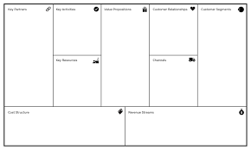




Revenue Streams:
Advertising, profit sharing (2.5%)
Customer Relationships:
Self-service via mobile app, Phone Support.,Rating users.,Feedback form
Key Resource:
Human Resources GCP, ML Tech, Android, IOS
Channels:
Platform Appstore, Social Commerce, Customer Review
Key Activities:
Application development, Connecting Peddler and Buyers s, research.
Value Proposition:
pengiriman gratis, can track location, Usability, accessibility
Key Partners:
Payment Gateway, Food Distributors, Packaging Providers, Investor.
Customer Segment:
Internet User, Students, Housewifi, staff peddle with range from 13 until 45r
Cost Structure:
Costs for operation, maintenance and development, Salary, Research
‹#›

Slide 24




Technology Implementation

Slide 25
THANK
YOU
SaKe Team

